Slide 1
Cyclic Generative Adversarial Networks for Photograph to Painting Translation
EE 541: A Computational Introduction to Deep Learning
Prof. Brandon Franzke
By
Aditya Anulekh Mantri (USC ID: 80849574464)
Shoumik Nandi (USC ID: 3621442772)
Prithvi Dalal (USC ID: 1939114566)

Slide 2
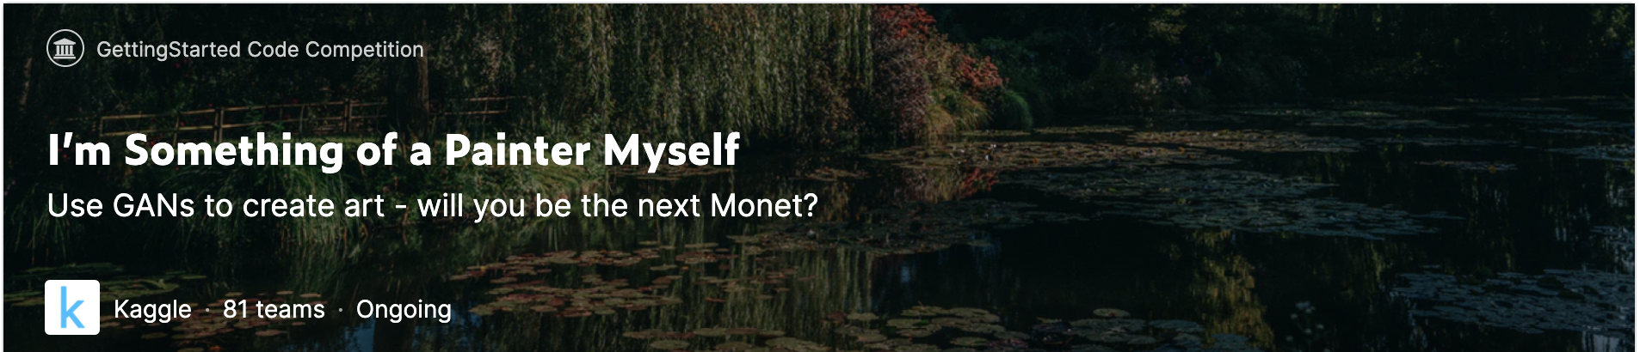
Competition
Objective : Convert photographs into Monet-Style images

Slide 3
Introduction
Aim - Create Monet-style images from photographs
Assume two domains - Monet paintings and Photographs - have some relationship and seek the relationship.
Two mappings : G : X → Y and F : Y → X . G and F are inverse of each other.
Introducing Cycle Consistency loss -> F(G(x)) ≈ x and G(F(y)) ≈ y
Dataset : 1. Dataset posted on the Kaggle competition
2. Dataset used by Zhu et al in original CycleGAN paper
Related Work: 1. Generative Adversarial Network (GAN)
2. Deep Convolutional Generative Adversarial Network

Slide 4
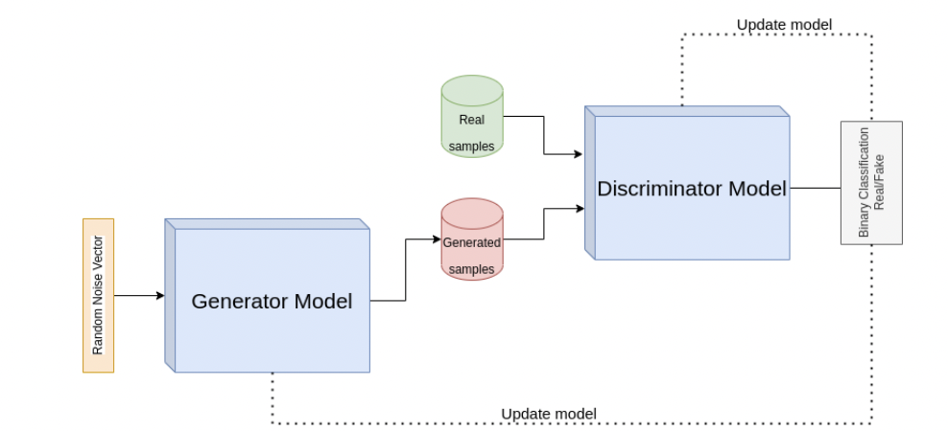
Introduction to Generative Adversarial Network

Slide 5
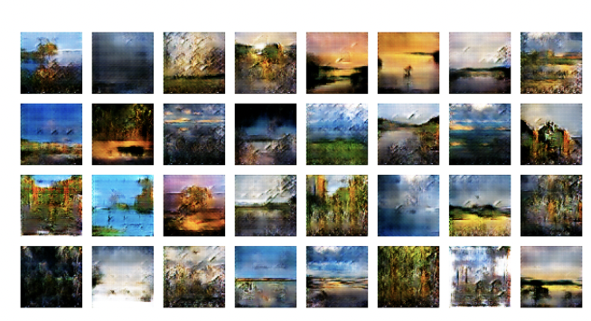
Deep Convolutional GAN - Results

Slide 6
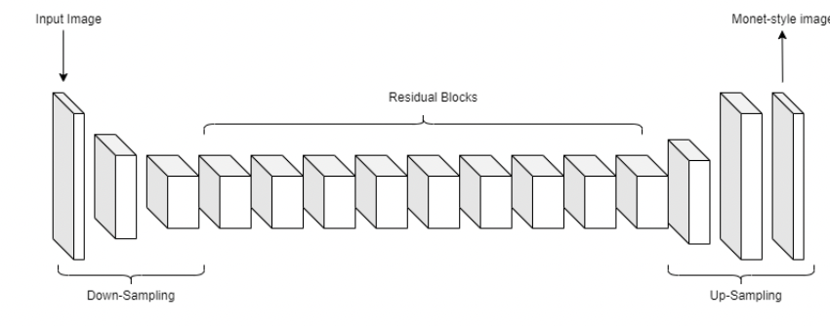
Architecture - Generator
The images in the Monet dataset and the photos dataset are not paired with each other. The goal of this project is to learn a mapping between the two domains given the unpaired training samples. To achieve this we need to construct two mappings F : Photos → Monets and G : Monets → Photos.
Generator Architecture: The network consists of : c7s1-64 → d-128 → d-256 → R-256 → R-256 → R-256 → R-256 → R-256 → R-256 → R-256 → R-256 → R-256 → u-128 → R-64 → cs71-3
Generator Architecture

Slide 7
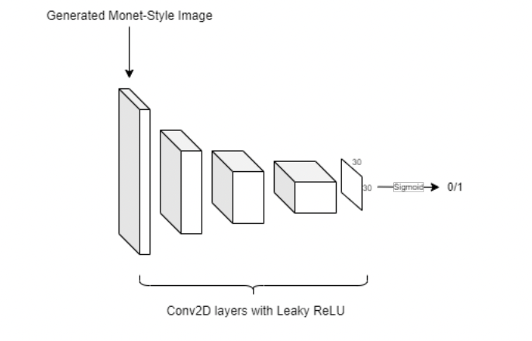
Architecture - Discriminator
Discriminator Architecture: The discriminator architecture consists of : C-64 → C-128 → C-256 → C-512
Discriminator Architecture

Slide 8
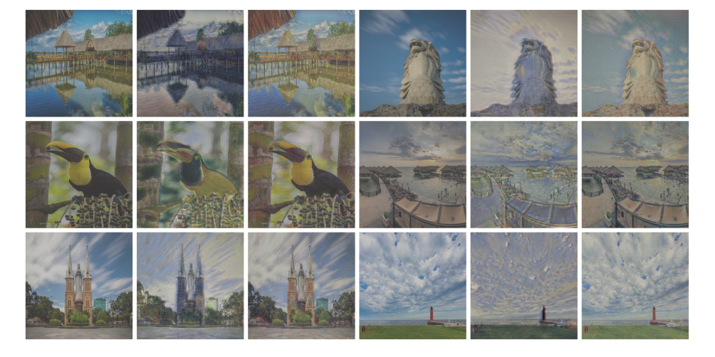
Architecture
Loss Function :
Adversarial Loss -------
Cycle Consistency Loss ----
Identity Loss : This loss helps preserve the color space between the input and output
Left to Right: Input Photo, Monet style painting using CycleGAN without Identity Loss, Monet style painting using CycleGAN with Identity Loss. Identity mapping loss helps preserve the color space of the input photograph.

Slide 9
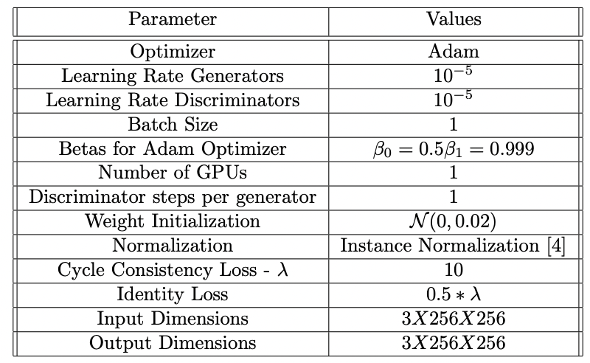
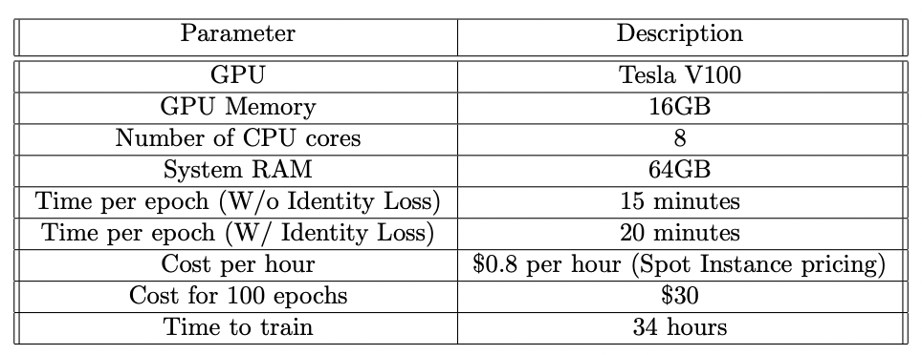
Training
Parameters:
Training Details:
First 30 epochs without identity loss - to speed up process
Next 30 epochs incorporating identity loss

Slide 10
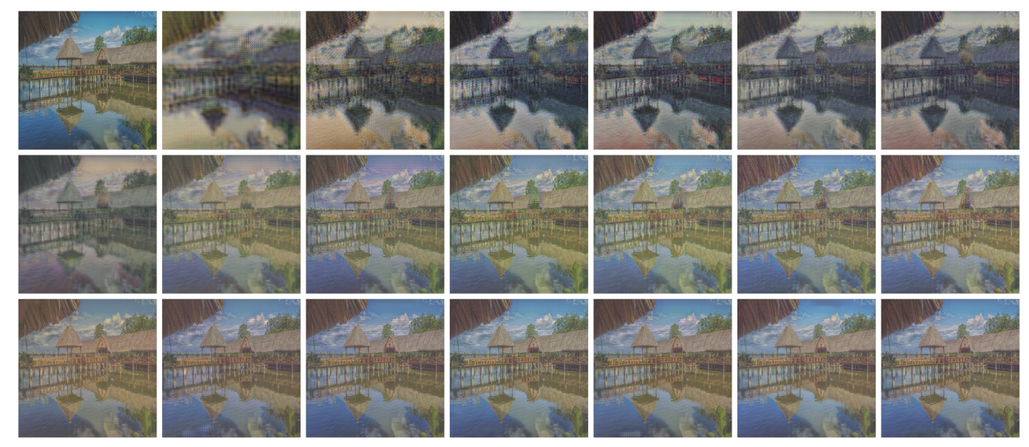
Training and Results

Slide 11
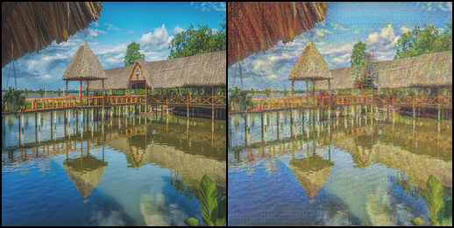

Slide 12
Thank You

